Slide 1


Master of Engineering Sciences - Computational Mechanics / CMI
Sorbonne University - 2017/2022
Graduating Internship at ONERA
Mesh adaptation of computational fluid dynamics (CFD) simulations of turbomachinery
Duvivier Valentin
Supervisor: Sâm Landier

Slide 2
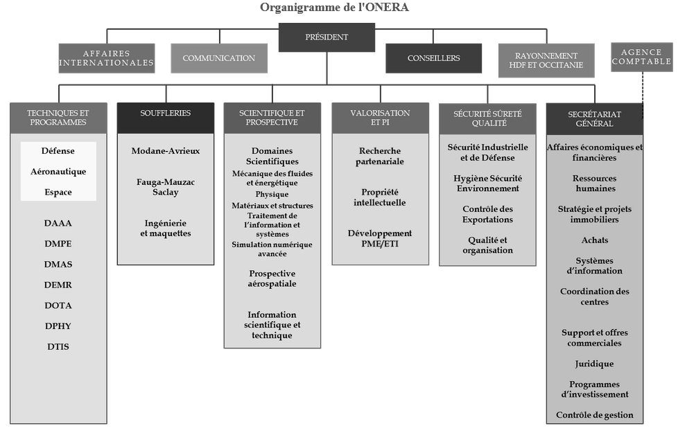
ONERA - DAAA
DEFI

Slide 3
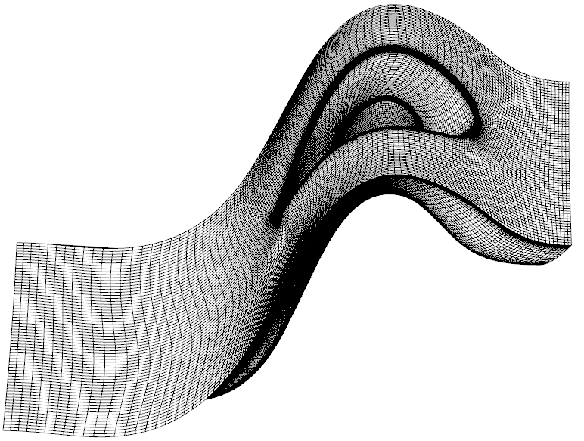
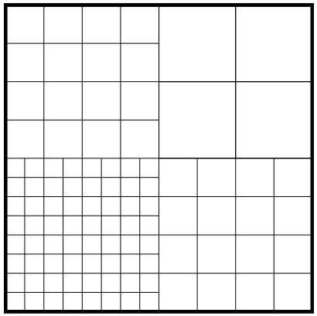
Cassiopee
Periodicity
Refinement
Ensure periodicity property while refining on edge

Slide 4
Plan
Adaptation process
Hierarchical adaptation
Intrinsic issues
Self-joined case
Introduction case
Validation one zone case
Multi-joins case
Rid process
Validation three zones case
Synchronization faces
Principle
Rotation periodicity
Validation three zones case
Turbomachinery CM2012 case
Shock function
Validation periodicity
4

Slide 5

Adaptation process
Hierarchical adaptation
Zone 1
Zone 2
Zone 3
ptLists
ref scheme
ptLists
ref scheme
…
$$Join = \left(zone 1, zone 2, list_faces_1\right) ⟷ \left(zone 2, zone 1, list_faces_2\right)$$

Slide 6
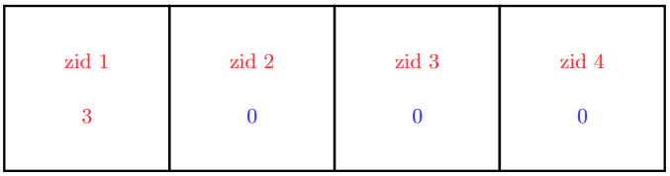
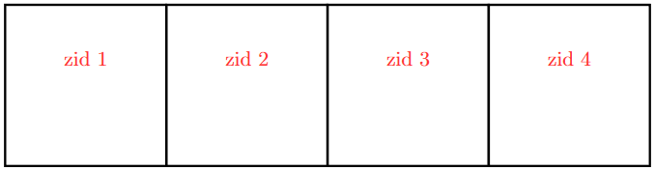
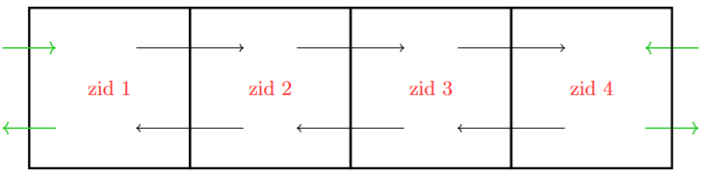
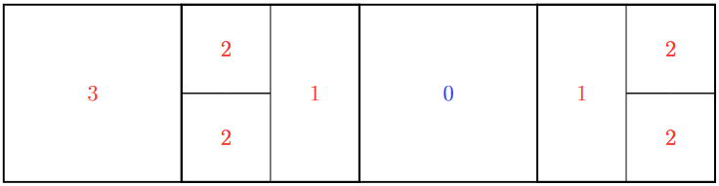
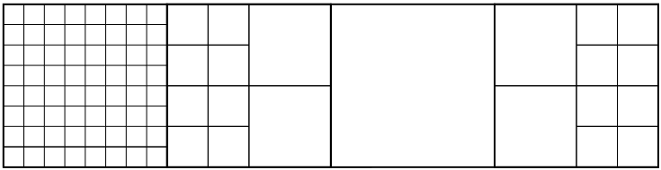
Hierarchical adaptation

Slide 7
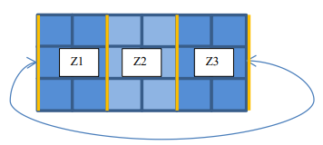
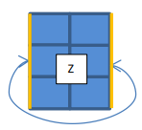
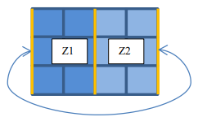
intrinsic issues
Working case
Issue 1 - Self-joined case
Issue 2 - Multi-joined case

Slide 8
Self-joined case
introduction case
$$Join = \left(zone 1, zone 1, list_faces_1\right) ⟷ \left(zone 1, zone 1, list_faces_2\right)$$
Join = $\left(zone 1, zone 1, [list_faces_1, list_faces_2]\right)$
getJoinsPtLists possibility for previous structure to read self-join
updatePointLists update lists once exchanges done
Python

Slide 9
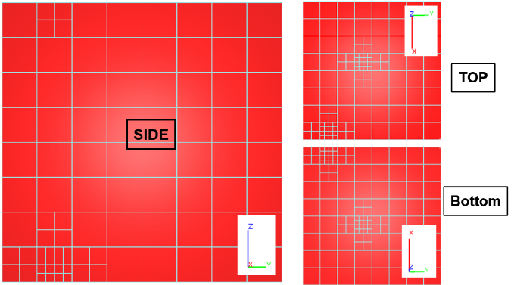
validation one zone case
Coincident faces
Transmission refinement
Same principle

Slide 10
Multi-joins case
$$Join = \left(zone 1, zone 2, list_faces_1\right) ⟷ \left(zone 2, zone 1, list_faces_2\right)$$
$$Join = \left(zone 1, zone 2, list_faces_3\right) ⟷ \left(zone 2, zone 1, list_faces_4\right)$$
$$Join = \left(zone 1, zone 2, \right) ⟷ \left(zone 2, zone 1, \right)$$
$$Join = \left(zone 1, zone 2, \right) ⟷ \left(zone 2, zone 1, \right)$$
Face index as criterion

Slide 11
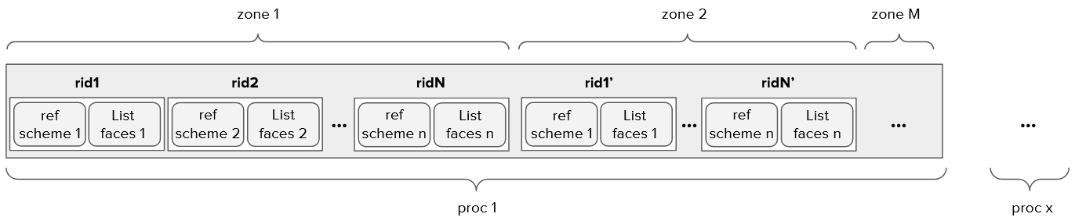
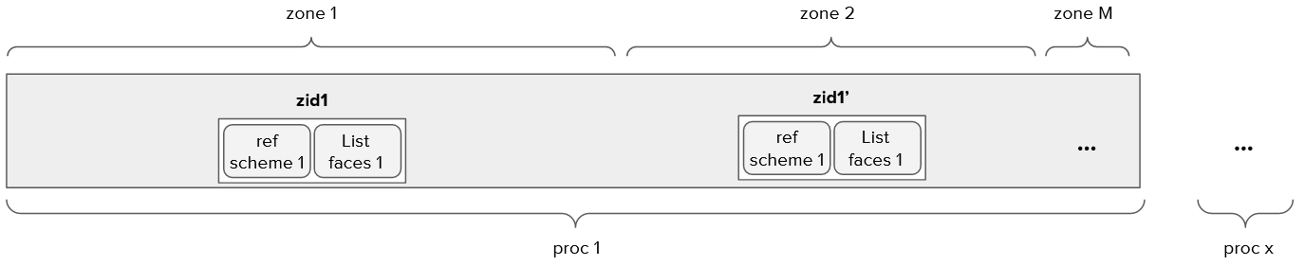
rid process
_exchangePointLists exchange and receive ptLists for modif and update
_adaptCells application refinement process to zones
convert_dico_int_pair_int conversion python data to C++ variables
Python
C++

Slide 12
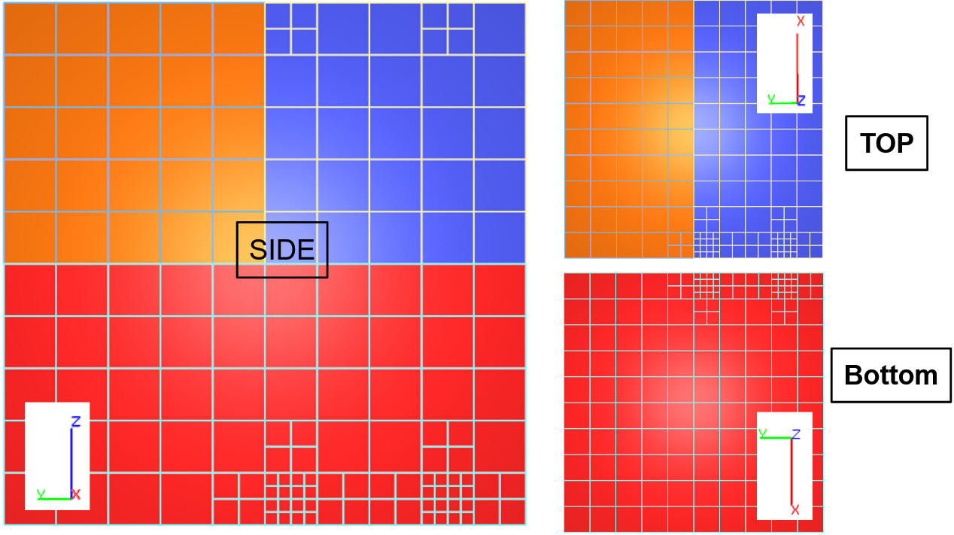
validation three zones case
rid feature
translation periodicity
towards complex configurations

Slide 13
Synchronization faces
Why rotation periodicity differs from translation periodicity in application of refinement process ?
Formalism for children ptLists:
exterior faces are outwards-oriented
faces must have ‘’same’’ first node
Good attribution of refinement informations

Slide 14
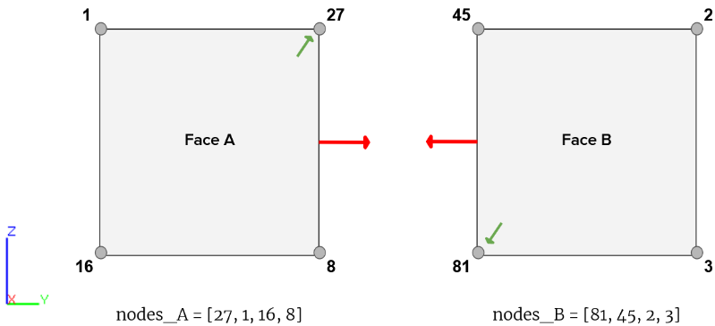
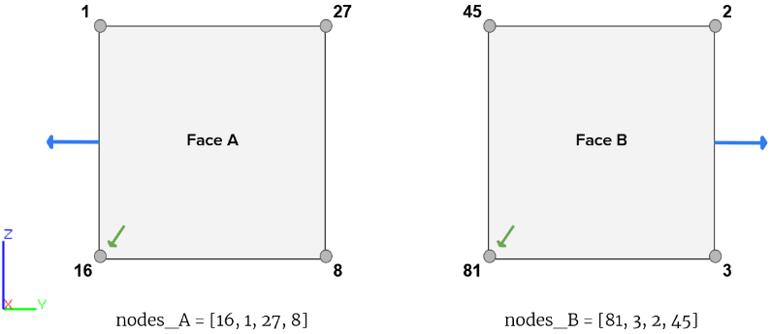
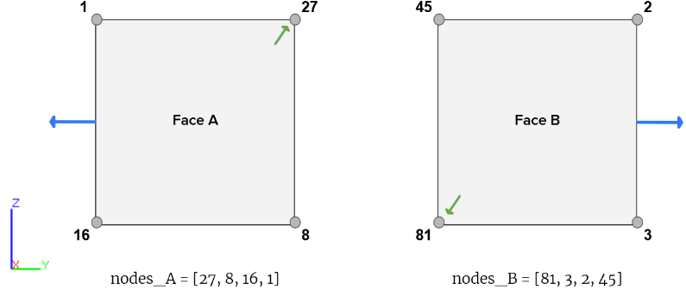
Principle – reorient_skin
Principle – initial state
Principle – shift_geom

Slide 15
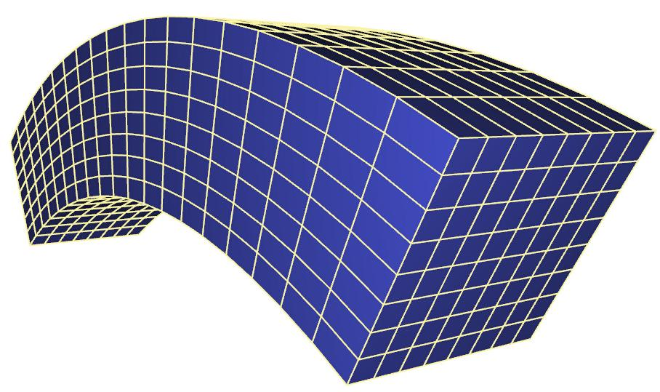

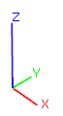
Rotation periodicity
No alignement
Not same framework
Not same first point
Ill definition
axial_rotate set both faces in same frame

Slide 16
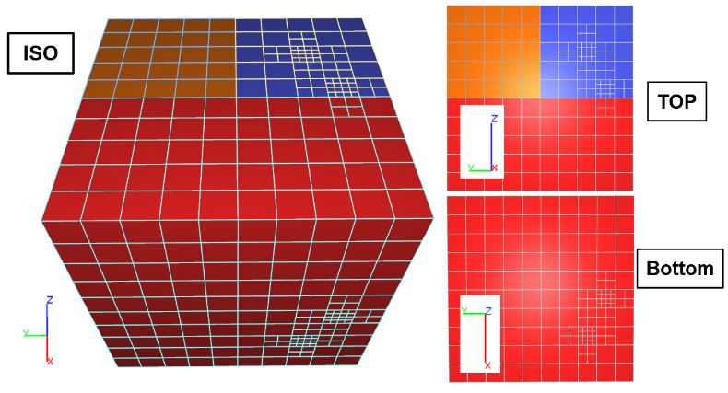
Validation three zones case
rid feature
self_join feature
Periodicity ensured

Slide 17
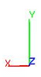
Turbomachinery CM2012 case
Shock function
Self-joined case
Rotation periodicity
3D Gaussian function
Shock

Slide 18
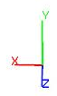
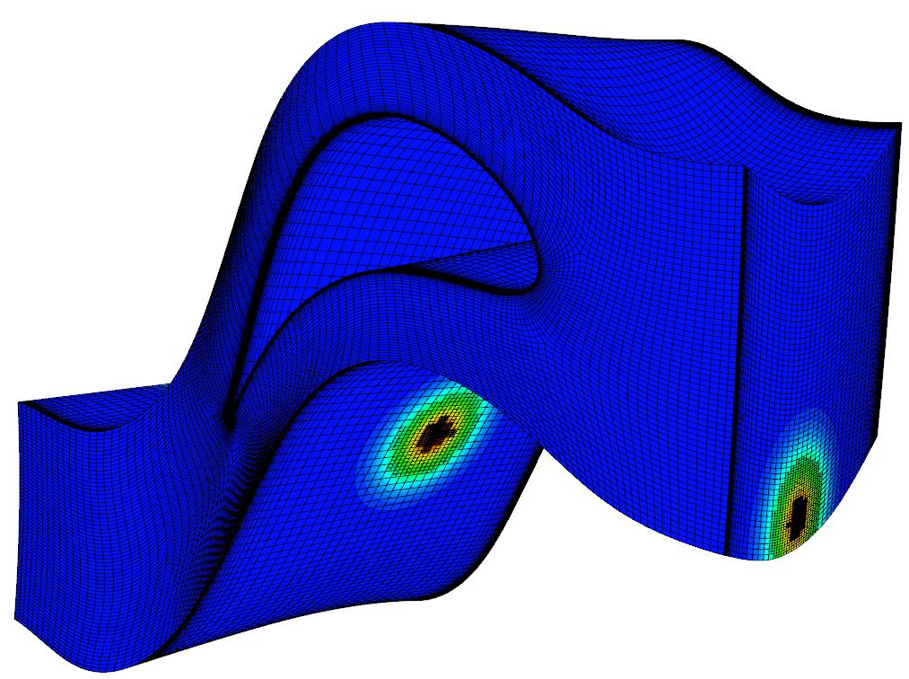
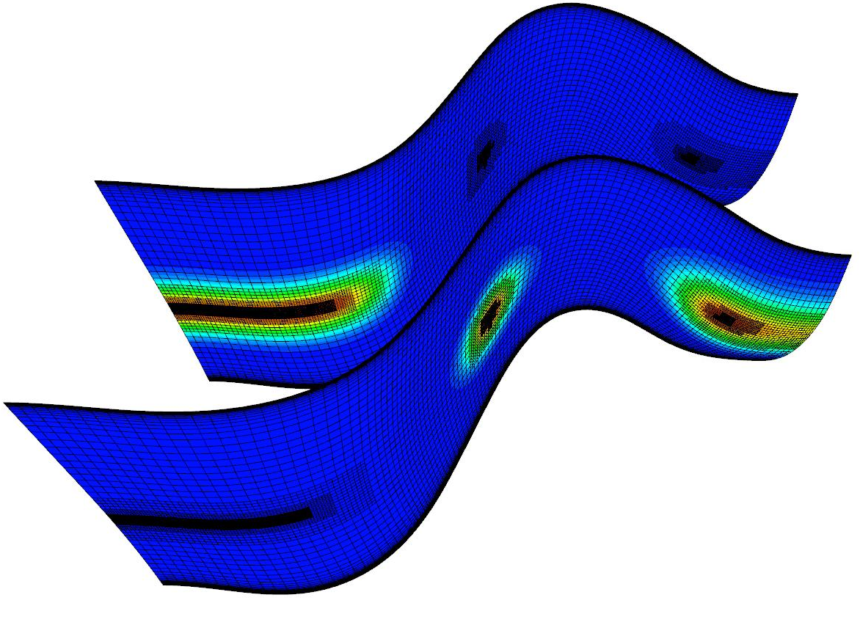
Turbomachinery CM2012 case

Slide 19
Conclusion
Periodicity property wasn’t ensured
Codes we implementated solved issue
Non-regression basis extended with our case
To come : use in CFD solvers, tests on industrial cases

